Slide 1
Khishore Kumar G B
EMPLOYEE ID: 153009
JEE FULL STACK, MIPL

Slide 2
Team Members:
Khishore Kumar G B
Vinitha Neeli
Pravalika Nayana
Archana

Slide 3
CapStore Shopping Application

Slide 4
Project Requirements

Slide 5
Softwares:
Java 10
STS Version: 3.9.4.RELEASE
MySQL 5.5 Command Line Client
HTML 5
CSS 3
BootStrap
JavaScript
JSP
Spring Boot (2.0.4)
Spring Rest
Notes:
Fixar a posicao do titulo – sempre do lado esquerdo.
Sempre que tiver muito texto o coluna deve sempre ser “ narrowed” , se nao fica dificil de ler. Colocar paragrafos no texto.
Linha vertical deve ser mais fina e as pontas NUNCA devem ser arredondadas.

Slide 6
Module
Updating Delivery Status

Slide 7
Updating the DeliveryStatus
The admin has to go to the DeliveryPage.
The admin has to enter the orderId in the DeliveryPage.
The order details for the entered orderId is fetched from the database and displayed to the admin.
The admin can update the status of delivery of the orders time to times.
Prior to this, Orders should be present for the admin to update the status.
The updated status is reflected in the database.
Using this DeliveryStatus the inventory and dateofdelivery is updated.

Slide 8
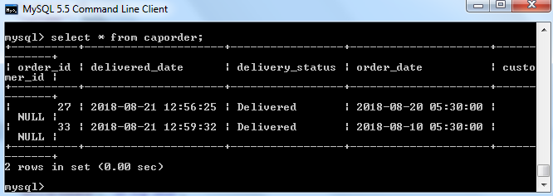
Tables Used
Order
orderId
deliveredDate
deliveryStatus
orderDate
customer

Slide 9
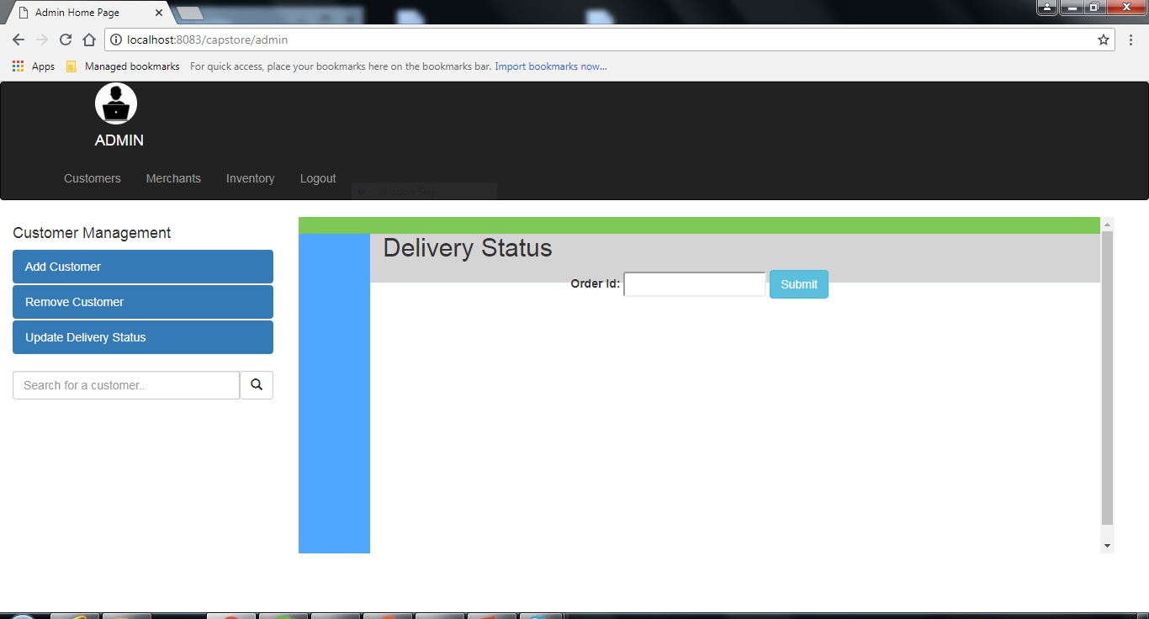
Getting OrderID

Slide 10
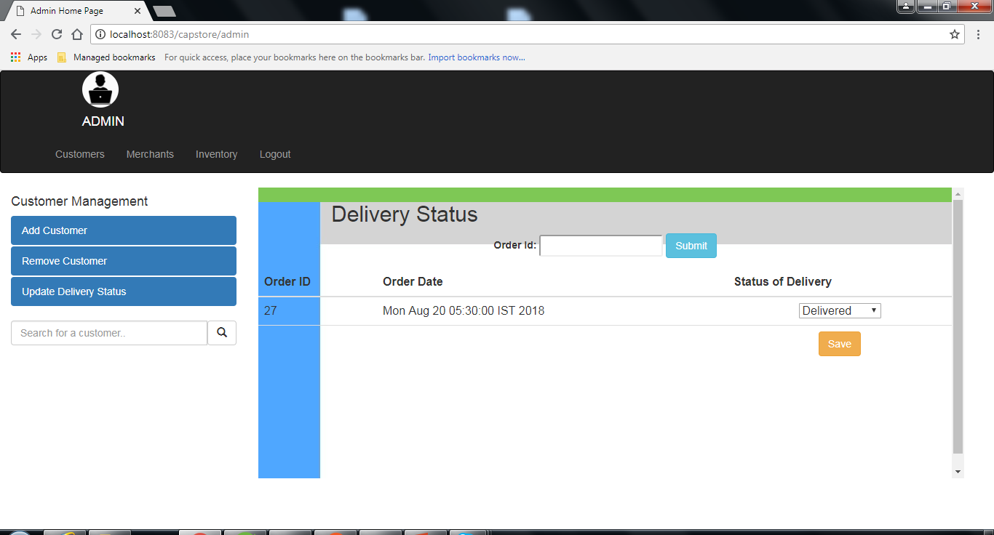
Fetching and Updating Delivery Status

Slide 11
Thank You
Notes:
O Box atras do texto desnecessario. Deixar o layout mais simples.

